Slide 1
Introduction to Proc means

Slide 2
Table of contents
Introduction to Proc Slide 3
Options Slide 5
Statistic Key words Slide 6
Other Statements Slide 9
Examples Slide 13

Slide 3
Summary of functionality
The main purpose of Proc Means is to give specific statistics of numeric variables
Although the Proc has the title Means attached to it, it can give numerous different types of statistics.
Although it only gives statistics for numeric variables, however, you can specify for the statistics to be by a specific variable

Slide 4
Style of the proc
PROC MEANS DATA=data OPTIONS KEYWORDS;
BY char_variables;
CLASS char_variables;
VAR numeric_variable;
OUTPUT OUT=OUTPUTTED;
RUN;

Slide 5
options
KEYWORD | DESCRIPTION
MAXDEC=n | Rounds the statistics to n decimal places
MISSING | Includes missing values in the analysis
NOPRINT | Runs a proc means but does not print

Slide 6
Keywords
keyword
Correlating statistic
KEYWORD | CORRELATING STATISTIC
Alpha= .n CLM | Two sided confidence with alpha .n
CSS | Corrected sum of squares
CV | Coefficient of variation
KURTOSIS | Kurtosis
LCLM | Lower Confidence Limit
MAX | Maximum Value
MEAN | Mean
MIN | Minimum Value
MODE | Mode
N | Number of nonmissing values

Slide 7
Keywords Continued
keyword
Correlating statistic
Keywords | Correlating Statistic
NMISS | Number of missing values
MEDIAN | Median
Q1 | First quartile
Pn | Nth percentile (only multiples of 10 or 1, 5, 95, 99)
RANGE | Range
SKEWNESS | Skewness
STDDEV | Standard Deviation
STDERR | Standard Error of the Mean
SUM | Sum
SUMWGT | Sum of Weighted Variables

Slide 8
KEYWORDS (FINAL)
KEYWORD
CORRELATING STATISTIC
KEYWORD | CORRELATING STATISTIC
UCLM | Upper Confidence Limit
USS | Uncorrected Sum of Squares Variance
VAR | Variance
PROBT | Probability for t
T | T value
Q3 | 3rd quartile

Slide 9
THE BY STATEMENT
Performs a separate analysis for each level of the variables specified in the statement
The data must be sorted first (use Proc Sort)

Slide 10
Class statement
Performs a separate analysis for each level of the variables specified in the statement
However, you do NOT need to sort the variables first
Additionally, the output is more compact, and they are not separately analyzed

Slide 11
Var statement
Specifies which numeric variables to use in the analysis
If it is absent, then Proc Means will take the mean of all the variables.

Slide 12
OUTPUT STATEMENTS
Creates a dataset via proc means
You can create variables in this step, specifically variables that relate to statistics
For example in the output step, if you make mean=AverageGrade on a dataset about quizzes, the output would have a variable named AverageGrade that was the mean of the quiz scores.

Slide 13
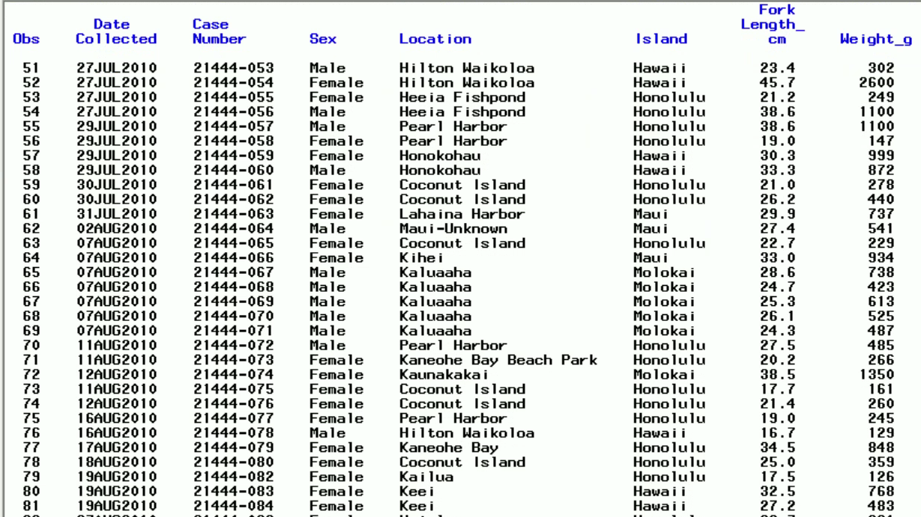
Example proc: (dataset used)

Slide 14
Example proc: Code
PROC MEANS DATA=IN03.PUFFERFISH MEAN MEDIAN P40 SUM STDDEV MODE CLM;
CLASS island;
VAR weight_g;
RUN;

Slide 15
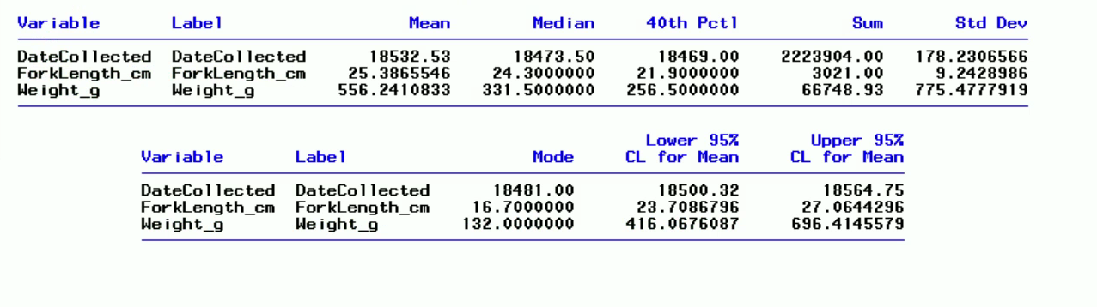
output

Slide 16
Example 2
PROC MEANS DATA=file.pufferfish MAXDEC=4 P50 RANGE SKEWNESS NMISS STDERR PROBT;
CLASS island;
VAR forklength_cm;
OUTPUT OUT=OUTPUTTED P50=MEDIAN_FORKLENGTH;
run;
PROC PRINT DATA=OUTPUTTED;
RUN;

Slide 17
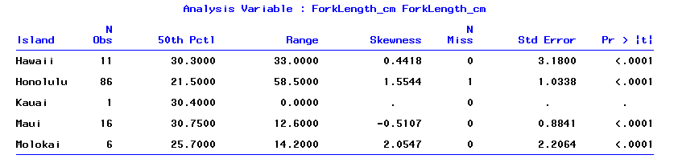
Proc means output

Slide 18
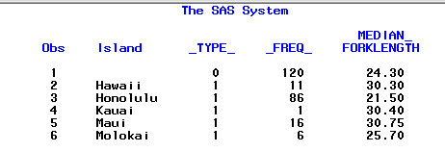
output

Slide 19
EXAMPLE 3
PROC SORT DATA=file.pufferfish OUT=EXAMPLE;
BY LOCATION;
RUN;
PROC MEANS DATA=EXAMPLE CSS MODE MEDIAN MEAN ALPHA=.01 CLM;
BY location;
VAR weight_g;
RUN;

Slide 20
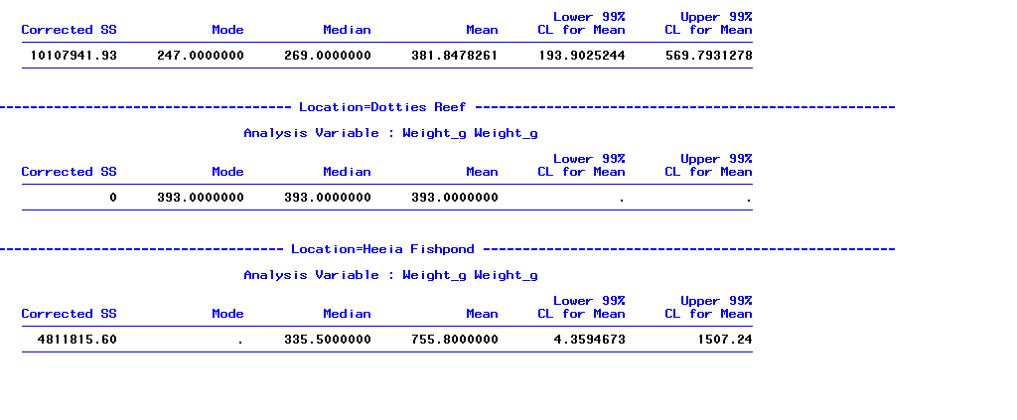
OUTPUT 3

Slide 21
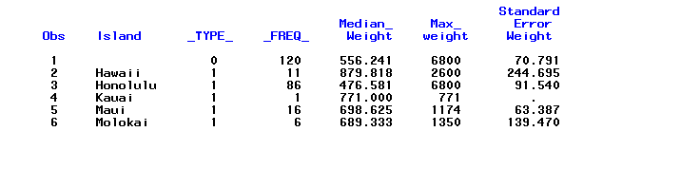
EXAMPLE 4

